Slide 1
CSE 323 SEC: 5 PROJECT: DEADLOCK SITUATION CHECKER. NAME: ALIF AL RAZI ID: 2011358042 NAME: Asif Moien Ornob ID: 1921680042 NAME: Nafeez Fuad Niladri ID: 1831095642 NAME: Asadujjaman ID: 1821301642

Slide 2
Objective: This project is about avoiding deadlock situation in a restaurant using c++ programming language of the help of well known concepts in operating system. We have taken Bankers algorithm here to avoid deadlock. Bankers algorithm with various concept like safe sequence.
System Requirements:
Hardware: Computer Software: IDE(Code Blocks, Turbo C++, Visual studio)
OS: MAC, Windows, Linux
Users: Restaurant admin
Analysis: Our target is to design a system by which restaurants get maximum benefits managing their customers. Restaurant Business is one of the dominant business in the world. Sometimes restaurants get such a situation, they can not manage overflowing crowd. Applying the bankers algorithm this situation can be managed by checking the restaurants position is in safe state or deadlock situation.
The processes are termed as Hall no of a restaurant. Max is number of persons, allocation is no of seats in per table. Need is needed seat in the hall. Available is no of available seat in the restaurant.
In first hall, if needed seat is greater than available seat it goes to next hall. If needed seat is smaller than available seats, then the persons need seat, take seat from available seat. The rest of the available seat is available’. Then the total number of people in the hall can complete their meal and it would be added with available’ and the summation is available”. Then it will check the next hall. This ways all the hall would be checked. If all persons can take meal it is safe state. If not then it would be in deadlock situation.

Slide 3
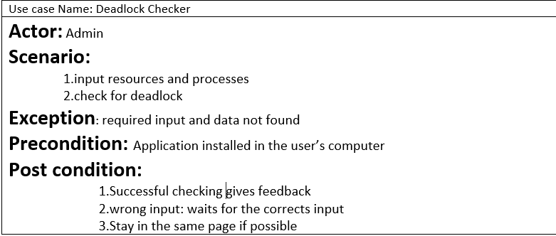
Design:

Slide 4
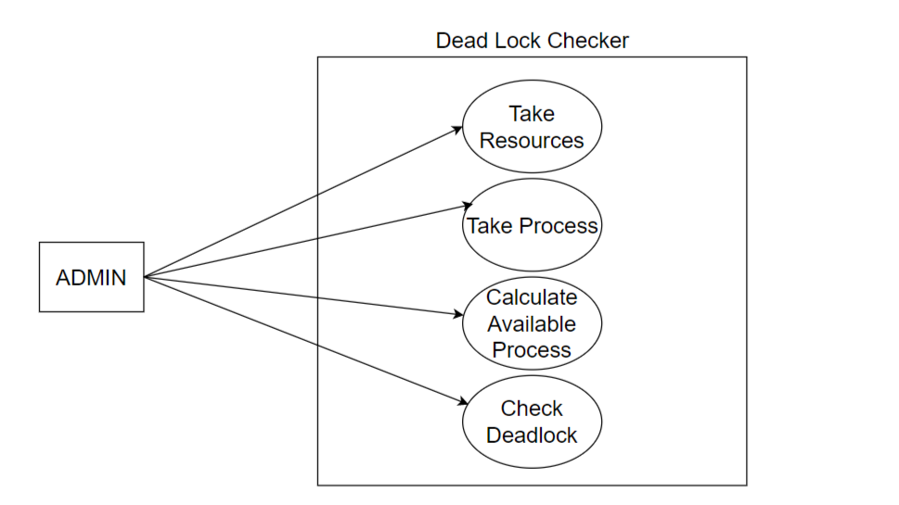

Slide 5
Implementation: The banker’s algorithm is a resource allocation and deadlock avoidance algorithm that tests for safety by simulating the allocation for predetermined maximum possible amounts of all resources, then makes an “s-state” check to test for possible activities, before deciding whether allocation should be allowed to continue. We have implemented the bankers algorithm to make sure of dead lock situation using c++.

Slide 6
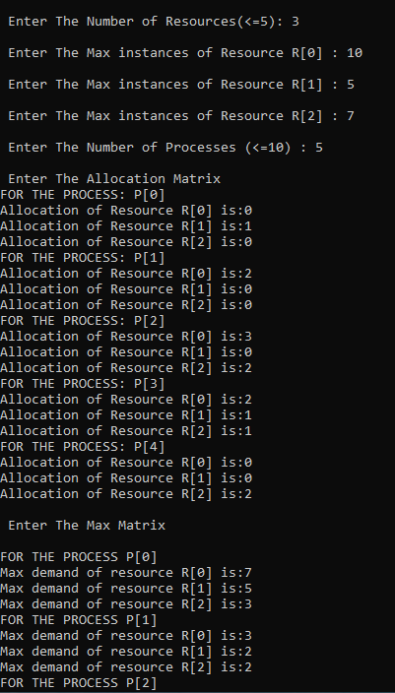
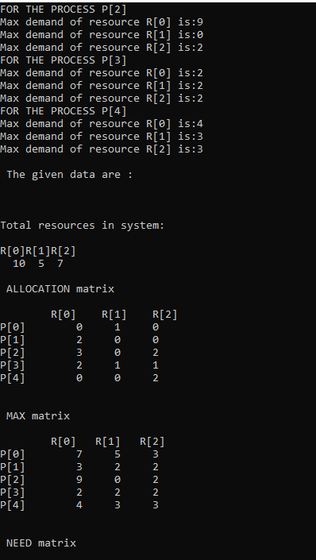
Product Lunching Output:

Slide 7
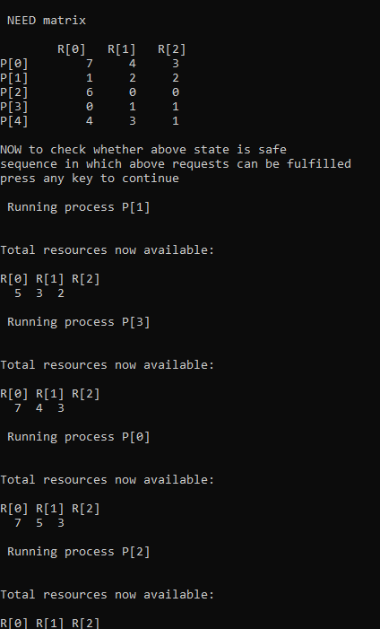
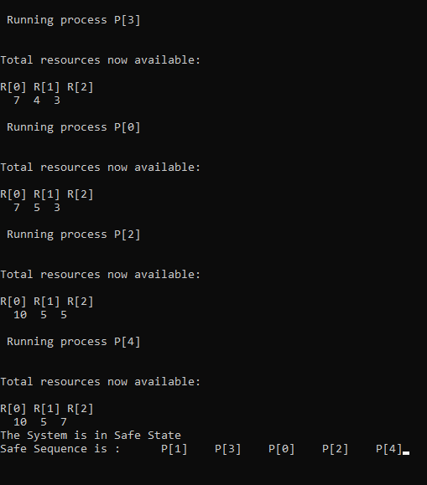

Slide 8
THE END
THANKS

